Slide 1
Fall Prevention: We all have a role to play MAY 4, 2018 Janet ipkeme Human Service Program ManageR Houston Health Department - Area Agency on Aging Sarah Schwaller, MPH Injury prevention coordinator Memorial Hermann Red Duke Trauma Institute Elena dinkIn, MSW director of active older adults ymca

Slide 2
Objectives
Describe the burden of falls and key risks factors for older adults.
Describe ways to prevent falls focusing on evidence base programs and community collaboration.
Provide examples of national, state and local resources relevant to older adult fall prevention.

Slide 3
Source: Image CDC Steadi
Notes:
***
How common are falls, currently?
Hard to wrap our minds around the scope of the problem – but to put it in perspective;
An Older Adult falls EVERY second of EVERY day in the US
Every 20 minutes an older adult dies from a fall.

Slide 4
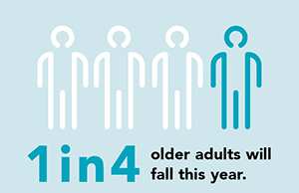
Image CDC Steadi
CDC BRFSS Analysis (2014)
Notes:
***
Falls are the leading cause of fatal and nonfatal injuries among adults aged ≥65 years (older adults)
Based on 2014 data, the estimated 29.0 million falls resulted in 7 million injuries.

Slide 5
10 Leading Causes of Unintentional Injury Deaths - All Ages 2014
Source: National Vital Statistics System, National Center for Health Statistics, CDC/National Center for Injury Prevention and Control

Slide 6
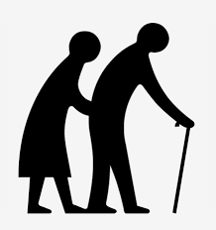
The Aging Tsunami
2060
98
Million
2014
46.2
Million
Age 65+
AOA, Aging Statistics (2016) www.aoa.acl.gov/Aging_Statistics/Index.aspx
A As for Surgery of Trauma (2016))
Notes:
***
Falls is just one area which will be impacted by what researchers call “the Aging Tsunami”.
Currently → OAs represent 14.5% of the population. (1 in 7 Americans).
By 2040, they will grow to be almost 22% (1 in 4). For the first time in history, older adults (over 65) will outnumber children under 5.
And by 2060 – there will be more than twice the number of older adults in the US.
US Trauma centers are seeing the effect of this population shift

Slide 7
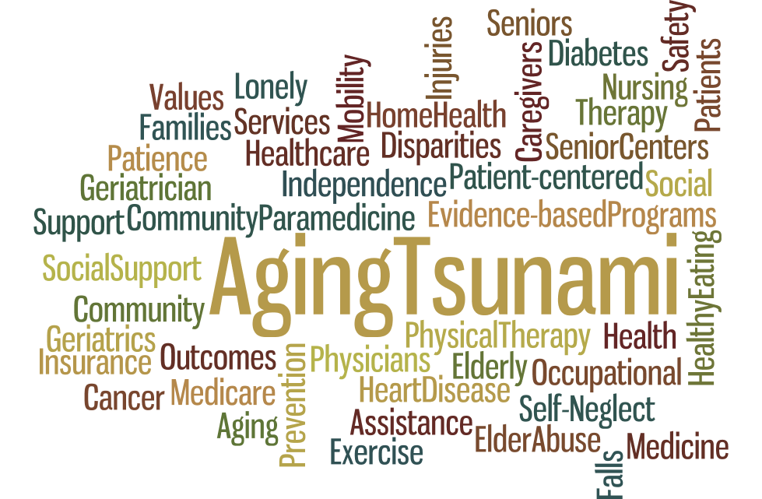
Notes:
This shift will impact many aspects of our society as we age.

Slide 8
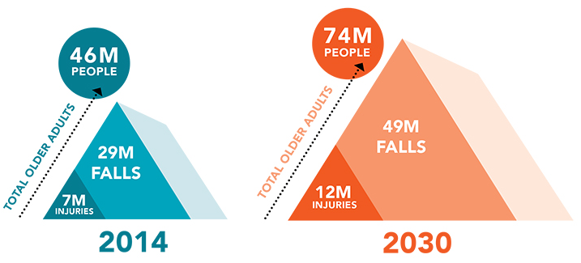
The Aging Tsunami; Falls are on the rise
Source: Image CDC Steadi
Notes:
Falls and fall injuries are going to rise, along with the aging population.
Based on this growth, we can expect 49 million falls and 12 million fall injuries in 2030

Slide 9
Economic Impact
Hospital
Costs
$34 billion-
Direct medical costs* for OA fall injuries
*2013, Adjusted for Inflation
CDC STEADI (2015) Important Facts About Fall
Carroll, N Et al. J Manag Care Pharm (2005).
Image (www.fairhealthconsumer.org/reimbursementseries
Notes:
Falls are VERY Costly
- Among the 20 most expensive medical conditions!
- In 2013, direct medical costs for OA falls—what patients and insurance companies pay—totaled $34 billion
Hospital costs account for two-thirds of the total
Medicare pays for about 78% of the costs of falls
?What do you think the average hospital cost is for a fall injury? About $35,000.
The costs of treating fall injuries goes up with age.

Slide 10
Falls – A Serious Public Health Issue
Each year…
2.5 million older adults - treated in EDs for fall injuries
700,000 patients - hospitalized because of a fall injury
27,000 older adults die as a result of a fall
Source: CDC 2011. Web–based Injury Statistics Query and Reporting System (WISQARS)
Notes:
700,000 patients a year are hospitalized because of a fall injury, most often due to a head injury or hip fracture.
-One out of five falls causes a serious injury such as broken bones or a head injury
The most common cause of traumatic brain injuries (TBI)
250,000 older people are hospitalized for hip fractures.
-More than 27,000 older adults die as a result of falls
-That’s 74 older adults every day

Slide 11
A Texas Public Health Issue
Leading
cause of injury in 2013
Direct medical costs associated with
falls among >50+ increased from
$1.9 to $3.1 billion from 2007
to 2011.
Texans Working for a Falls Free Tomorrow
Notes:
Certainly see the trends reflected in Texas

Slide 12
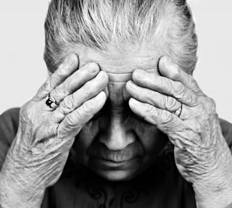
What happens after a fall?
1/5th of falls result in a serious injury
Severe trauma can lead to:
Long hospitalization
Rehabilitation
Permanent functional
impairment
Shame, social isolation,
depression
Death
Notes:
***
Talked about economic impact, what about the impact on quality of life ?
While many falls do not cause an injury – 1/5 falls does cause a serious injury.
These injuries can make it hard for a person to get around, do everyday activities, or live on their own.
25% - move to nursing home one year after a fall

Slide 13
What happens after a fall?
Common injuries
Fractures
Superficial/contusion injuries
Open wounds
Other
Sprains/strains, bruising internal organ injuries, dislocations
Owens (2009) Statistical Brief #80/ Agency for Healthcare Research and Quality
Notes:
***
These are some of the common injuries.
FRACTURES
- Up to 12% of all falls in the elderly are followed by a fracture.
- More than 95% of hip fractures are caused by falling, usually by falling sideways. Osteoporosis increases
the risk for hip fractures
OTHER
Falls are the most common cause of traumatic brain injury in the elderly.
- In older patients who fall, head trauma is the most common cause of mortality
- The frequent use of anticoagulants for comorbid conditions in this population leads to an increased risk
of hemorrhage, even with low-velocity head trauma

Slide 14
Fall Prevention is Important
Our population is aging rapidly
A leading cause of:
Injury-related 911 calls
ER visits
Deaths in the elderly
Falls are preventable!
Notes:
As you’ve learned so far….

Slide 15
Recognizing Fall Risk Factors
Notes:
***
So, what are the factors that increase the likelihood that an older adult will fall??

Slide 16
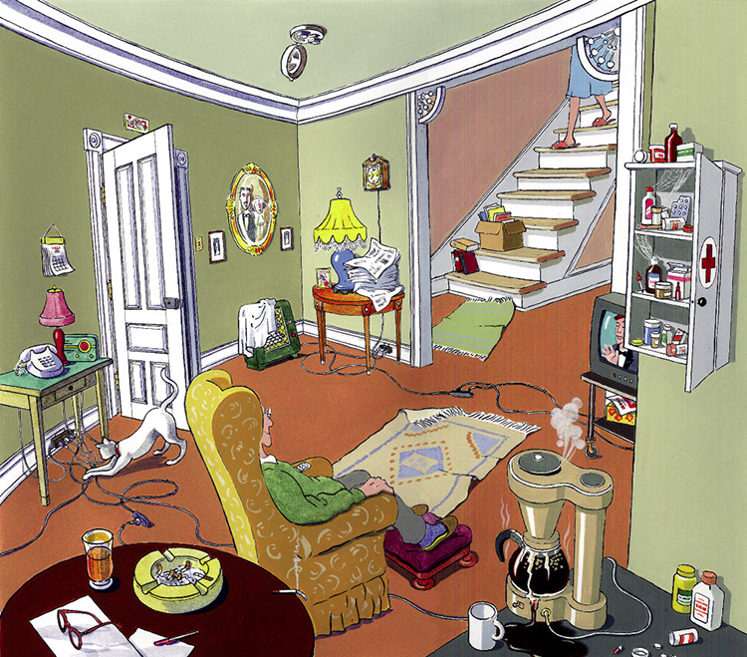
Fall Risk Factors - Older Adult Population
Some risk factors are more intuitive:
Older age
History of falls
Gait and balance problems
Postural Hypotension
Environmental hazards
Behavioral/distractions
The Hazardous home

Slide 17
Fall Risk Factors -Older Adult Population
Others are less commonly recognized:
Poor vision
Comorbid chronic conditions
Feet problems/ footwear
Medication issues
Urinary incontinence
Recent major life changes
Poor mental health
Improper use of assistive device
Notes:
Chronic conditions (arthritis, diabetes, stroke, Parkinsons, dementia)
Osteoporosis, while not a risk factor for falling, increases the likelihood of a fracture in the event of a fall.
The risk of falling increases with the number of risk factors present, and as people age, the occurrence of multiple risk factors increases

Slide 18
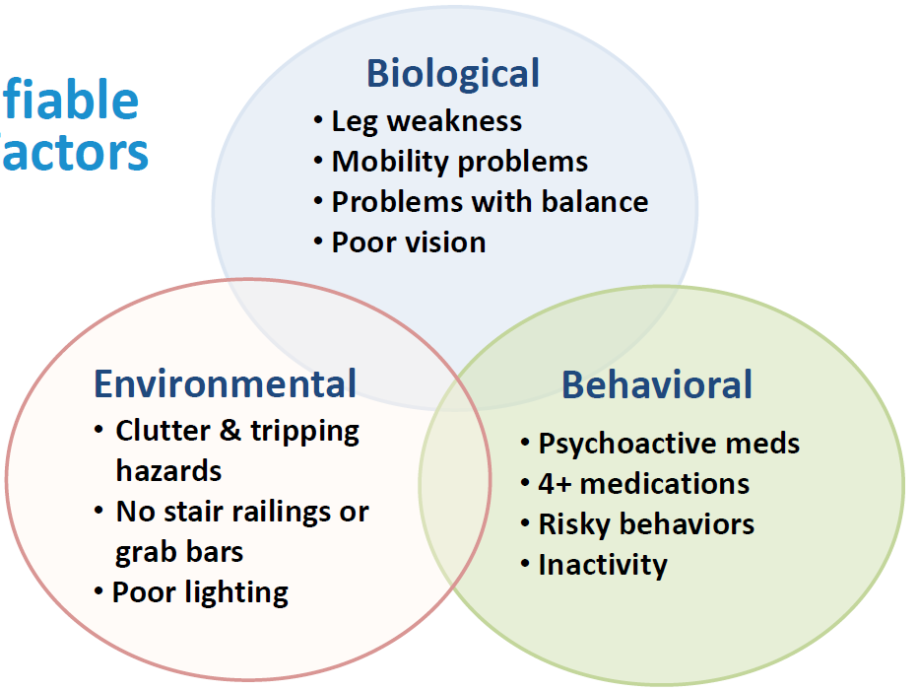
Modifiable Risk Factors
Image Source: CDC
Notes:
We are particularly interested in risk factors that can modified.
Briefly list.
Psychoactive medications examples include: Prescription drugs, OTCs, herbal supplements which can cause dizziness, sedation, confusion, blurred vision, or orthostatic hypotension

Slide 19
How to Assess for Risks

Slide 20
Risk Assessment
Self-Assessment
Stay Independent
12 Questions
Y/N
2 Minute Test
Have you fallen in the past year?
Do you feel unsteady when standing or walking?
3. Do you worry about falling?
Answering YES to one or more questions on the Two Minute Test or >4 score on the Self-Assessment indicates an increased fall risk!
Notes:
Many different screening tools and approaches, but the most simple
If fall risk factors are observed; assess for risk even if the person has never fallen

Slide 21
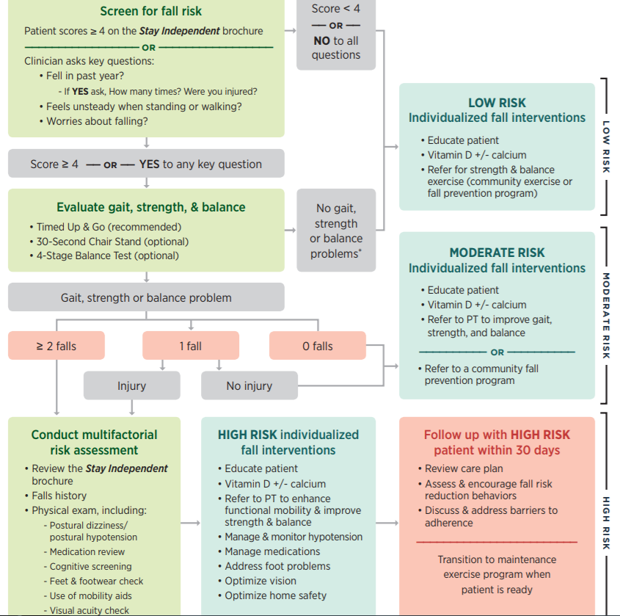
STEADI Algorithm
Image Source: CDC Steadi www.cdcsteadi.org

Slide 22
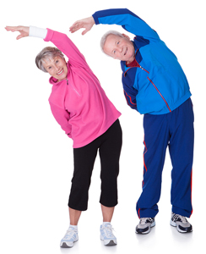
Interventions
Clinical assessment and risk reduction
Exercise
Medication Management
Home Modification
Multi-Component Strategies
Video Link
Stephens 2005 NCOA Falls Free
Notes:
Multiple types of interventions. Some are only effective in conjunction with other strategies.
-Falls are frequently caused by an interaction between personal and environmental factors, effective interventions have generally included components to address multiple risk factors.
Interventions vary based on the needs of the population. Nursing homes --different approaches than community dwelling older adults.
Most effective - clinical assessment + individualized fall risk reduction AND follow-up. Can lower the risk
of falling by 18%.
- Individualized
May look at - Gait, balance, neurological function, med review + individualized
intervention and referrals to PT/OT etc.
Exercise = most effective single intervention. Reduced the risk of falls by 12% - balance and gait training, strength building, balance retraining, muscle strengthening
Med review/modification review all patients’ medications and eliminate those not absolutely necessary. ->reduce fall rates.
Studies - home modification alone will not reduce falls, environmental factors do play a part in about half of all home falls. Should be focused on those at a higher risk of falling.

Slide 23
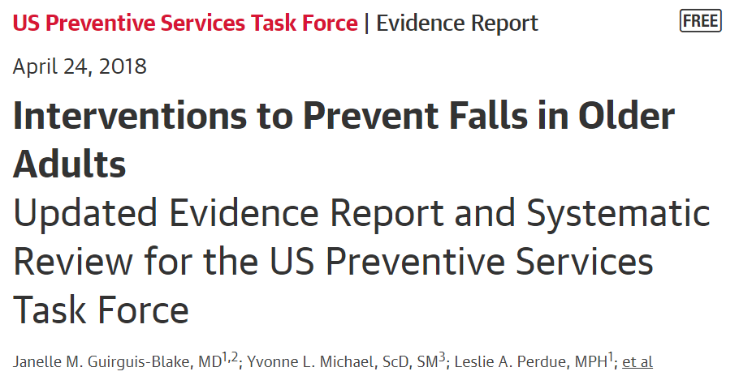
"The USPSTF recommendation, with increased emphasis on exercise, warrants adoption and should prove helpful, especially because exercise interventions reduce injurious falls,"

Slide 24
Collaboration is Key!
Notes:
Several consistent patterns and beliefs:
Falling is just a part of getting old
It is EMS’ job to deal with a patient who falls.
I don’t want to be liable…
The doctor should be asking their older adult patients about falls
I fell but I didn’t get hurt, so I don’t want to bother the doctor
Someone else is reviewing their medications
My dad will just think I’m trying to make him move out of his house if I try to start making changes to his home.
“You know, my daughter and my doctor had been telling me the same thing, but I didn’t really listen until this class”
Evidence-based fall prevention needs to be pushed from multiple directions…family, health care providers, senior living, community leaders, pharmacists etc

Slide 25
Local Collaborations
Houston Health Department and Southeast Texas Regional Advisory Council
A Matter of Balance lay-leader classes
UT School of Nursing & Harris County Emergency Corps
Home Safety Assessment Pilot Project
YMCA, Memorial Hermann & UTOrtho
Bone Health and Fall Prevention Education and Screenings
Harris County Housing Authority & Memorial Hermann
A Matter of Balance Classes
Harris County Public Health, EMS Agencies, Harris County Precincts & Community Organizations
Various Fall Prevention Initiatives
Notes:
Some examples of

Slide 26
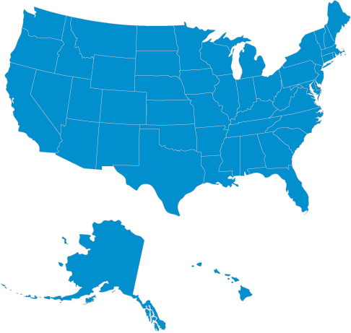
Resources
STEADI - CDC Go4Life – NIH Spell out acronym Healthy Aging- NCOA StopFalls.org - Fall Prevention Center of Excellence | Texas Falls Prevention Coalition Texas A&M Center for Population Health & Aging Health & Human Services Commission | Area Agencies on Aging Local senior centers YMCA Care Connection Baker Ripley Care for Elders Southeast Texas Advisory Council Harris County Public Health- Nutrition & Chronic Disease Prevention Outpatient Physical Therapy Hospital systems 211
Google Images

Slide 27
Houston Resources
A Matter of Balance
SETRAC
Local hospitals (St. Joseph, Harris Health, Northwest)
Baker Ripley
Houston Health Dept. AAA
YWCA
Older Adult Exercise Programming
YMCA
Silver Sneakers/Silver & Fit Affiliates
Senior and Community Centers*
OTAGO
Memorial Hermann TIRR
Baylor (?)
Home Assessment
Houston Health Dept. AAA-Healthy Homes Fall Prevention Program
Aging-related education/coalitions
UT Consortium on Aging
Harris County Public Health- Nutrition & Chronic Disease Prevention
Elder Service Provider Network
*General Aging Resources
Houston Health Dept. AAA Care Connection
Houston Galveston Area AAA
United Way 211
Notes:
211 is a program of the Health and Human Services
There may be fees associated with these resources

Slide 28
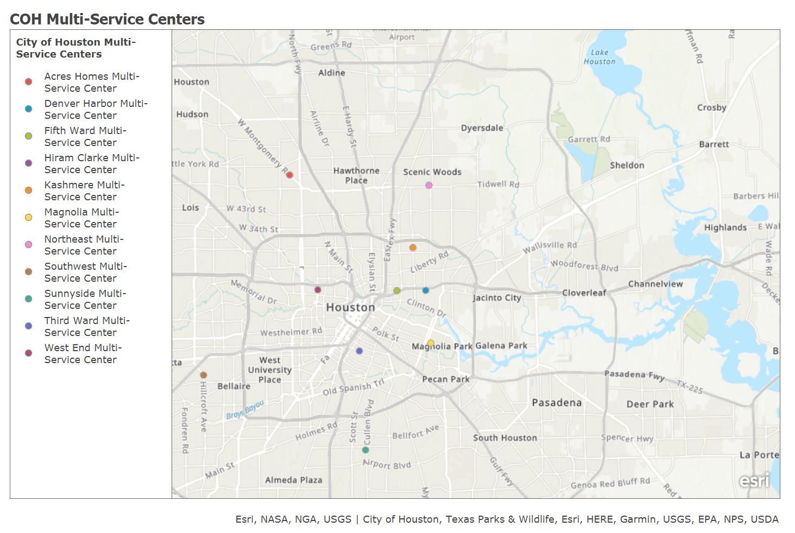
Houston Resources

Slide 29
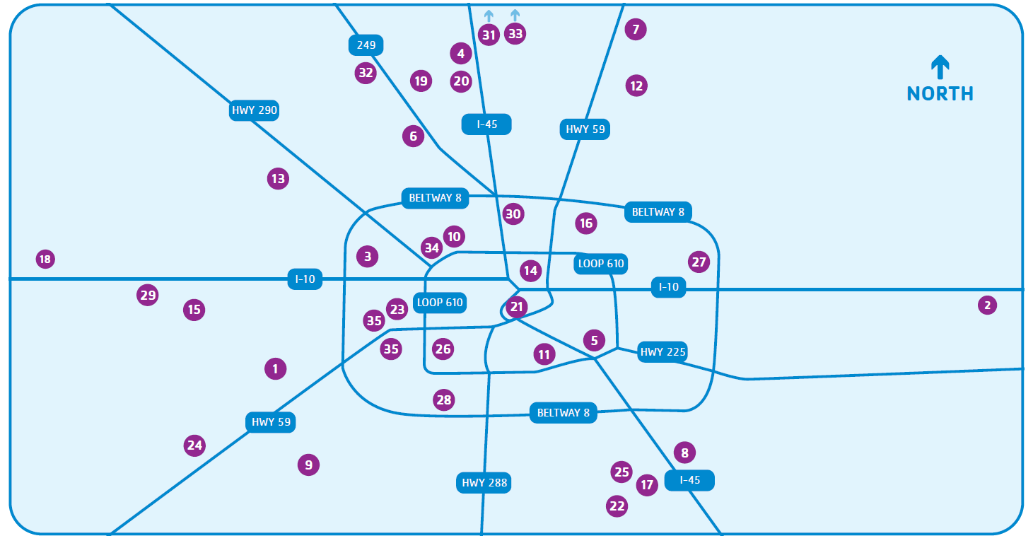
Houston Resources

Slide 30
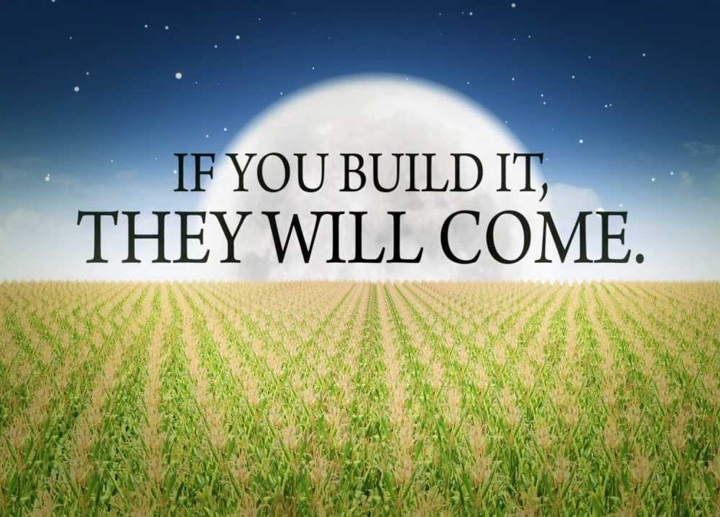
Notes:
Providing resources is just the first step – must engage seniors in programming

Slide 31
Keys to Successful Programming
Make exercise fun!
Know your population
Go where older adults congregate/live
Involve potential participants in planning and implementation process
Engage active leaders or members to spread the word
Make it a comfortable environment
Offer a variety of programming to fit different needs
Notes:
Know your population. Try to have options to fit different needs, levels, interests
Get direct input regarding preferences, preferred schedule perceived barriers to engaging in fall prevention
Find a member or leader that is engaged, and ask them to help you spread the word

Slide 32
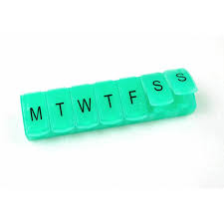
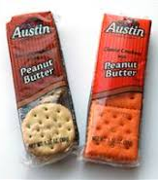
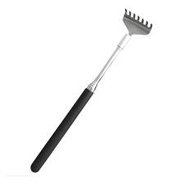
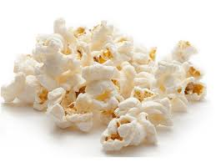
Keys to Successful Programming
Get creative with space
Plan info sessions prior to starting new programming
Don’t forget marketing and promotion
Recruit high-energy, passionate instructors
Offer raffle prizes, incentives and snacks
Notes:
Get direct input regarding preferences, preferred schedule, perceived barriers to engaging in fall prevention

Slide 33
Keys to Successful Programming
Cultivate opportunities for social support
Ask for feedback
Never stop making improvements
Don’t give up!
Images: www.salvationarmyindiana.org
Notes:
Employ easy, quick, short surveys to get feedback. Host informal discussions to find out what works, what doesn’t

Slide 34
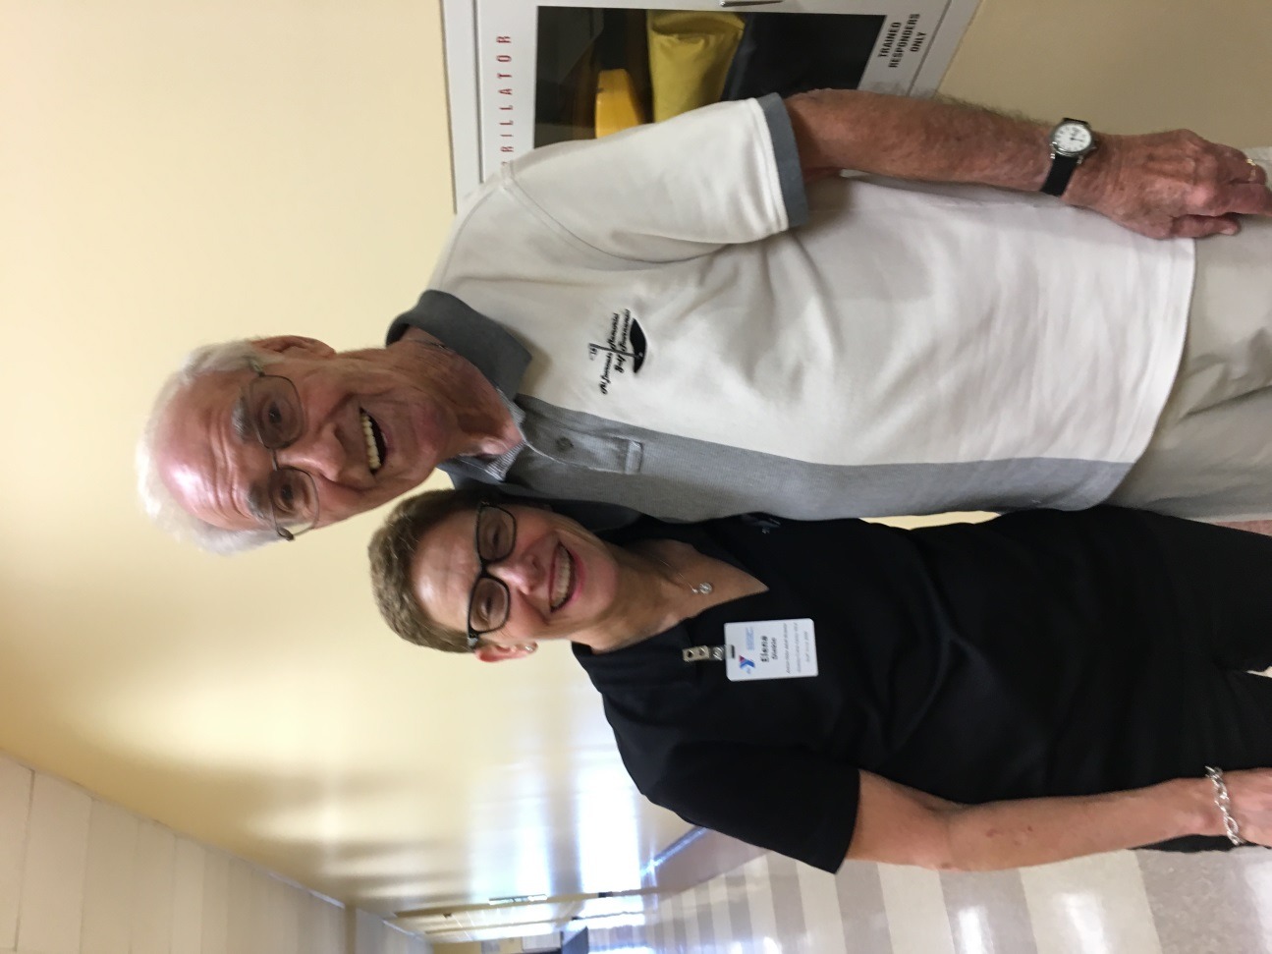
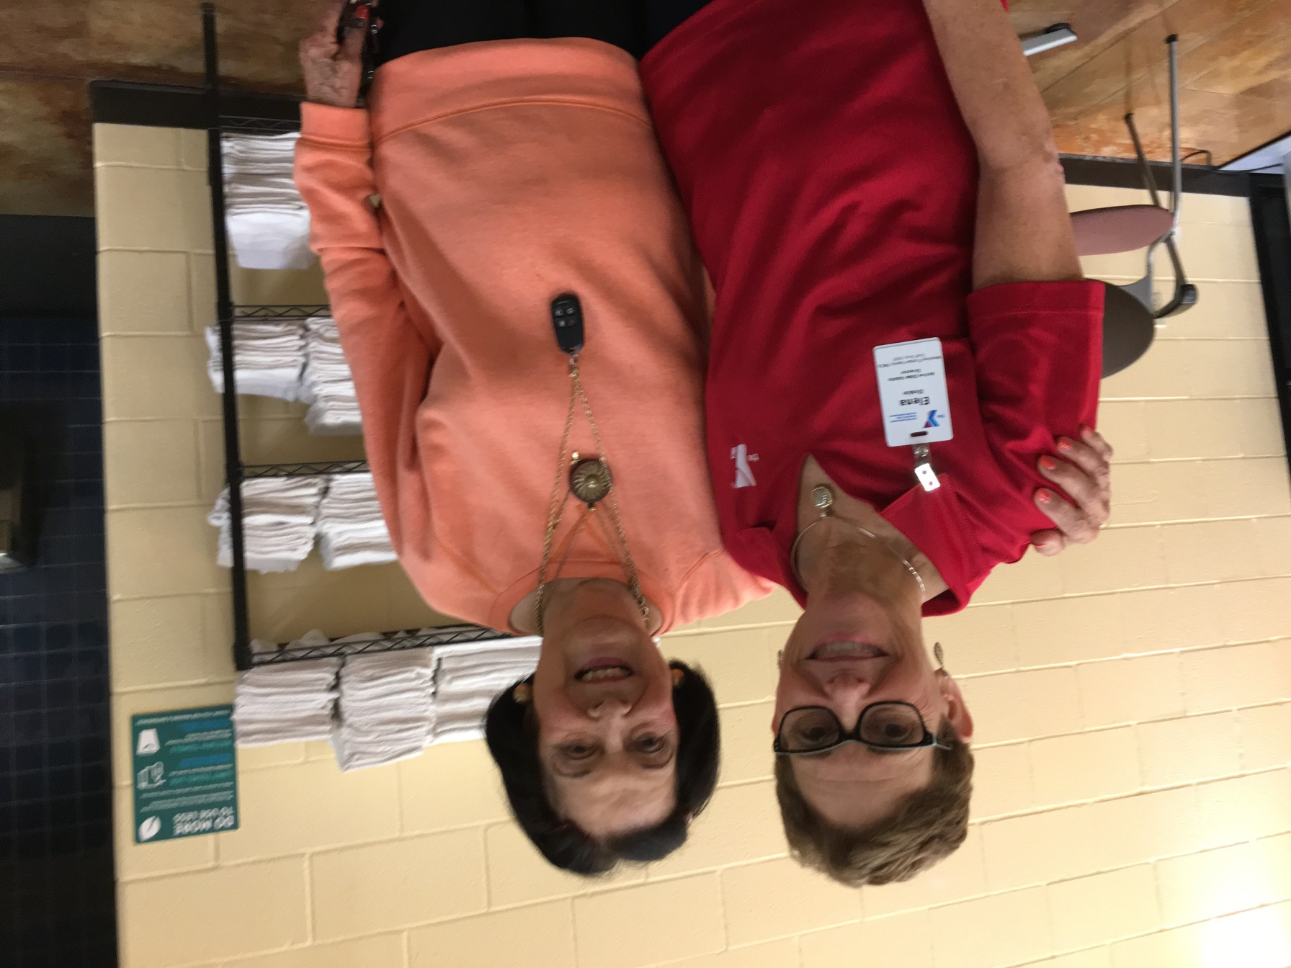
Inspiring Transformations
Notes:
Talk about a success story

Slide 35
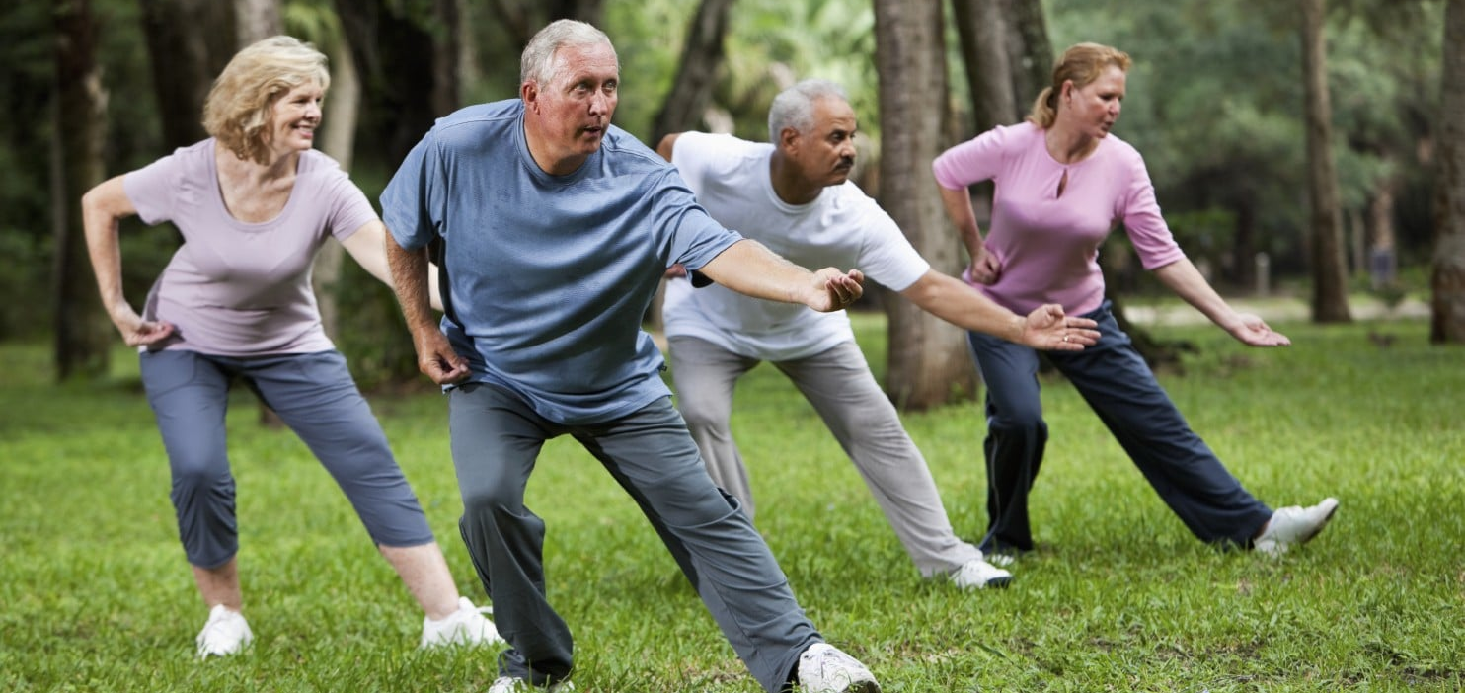
Questions?

Slide 36
Thank You!
Elena Dinkin
elena.dinkin@ymcahouston.org
Janet Ipkeme
Zaida.Ikpeme@houstontx.gov
Sarah Schwaller
Sarah.schwaller@memorialhermann.org

